Slide 1
Automated English Style Tutoring
Anish Tondwalkar
Juan Arrivillaga
Prateek Agrawal

Slide 2
Inspiration
The English language have become the de facto language for communication.
Non-native speakers face difficulty in expressing their thoughts in written English
Access to human tutors is expensive, and often logistically difficult
We present an automated approach to english tutoring

Slide 3
Contributions
Incorrect or stylistically incongruent text highlighted with a heatmap
Redder text -> more likely to be incorrect

Slide 4
Contributions
Incorrect or stylistically incongruent text highlighted with a heatmap
Redder text -> more likely to be incorrect
We make sentence-level suggestions to replace "bad" text with better

Slide 5
Contributions
Incorrect or stylistically incongruent text highlighted with a heatmap
Redder text -> more likely to be incorrect
We make sentence-level suggestions to replace "bad" text with better
Usability studies have found that using heatmaps to visualize errors performs well in helping humans deal with suggestions that may have a negligible false positive rate.

Slide 6
Related Work
Deep Learning Language Models
Automated Tutoring

Slide 7
Deep Learning Language Models
Deep Learning approaches in NLP involve Word2vec model by Mikolov et al.
This model learns word embeddings in vector space.

Slide 8
Deep Learning Language Models
Deep Learning approaches in NLP involve Word2vec model by Mikolov et al.
This model learns word embeddings in vector space.
There are 2 basic implementations
Skip-Gram Model
Continuous bag of Words(CBOW)

Slide 9
Skip-Gram Model
CBOW Model
Skip-Gram predicts the context words from target words
CBOW predicts the target words from the context words

Slide 10
An Example
For example “The quick brown fox jumped over the lazy dog”
Taking the context window as 1. So, we get (context, target) pairs as
([the, brown], quick), ([quick, fox], brown), ([brown, jumped], fox), ...
For skip gram model we will predict context from target
(quick, the), (quick, brown), (brown, quick), (brown, fox), ...

Slide 11
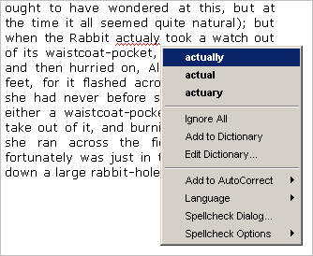
Automated Tutoring
Spell checkers

Slide 12
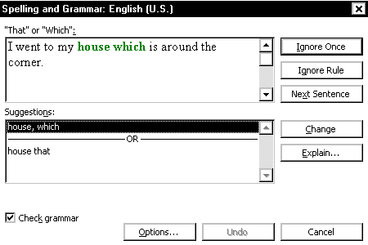
Automated Tutoring
Spell checkers
Rule-based Grammar checkers (commercially successful, e.g Grammerly)

Slide 13
Automated Tutoring
Spell checkers
Rule-based Grammar checkers
No prior work using statistical techniques

Slide 14
Automated Tutoring
Spell checkers
Rule-based Grammar checkers
No prior work using statistical techniques.
Can we do better with statistical text mining techniques? Can we convey writing style?

Slide 15
LIVE DEMO!

Slide 16
Data sets
Gachon
Reuters
Wikipedia

Slide 17
Datasets
Gachon Dataset
http://koreanlearnercorpusblog.blogspot.kr/p/corpus.html
Consist 2.5 million tokens
25000 participants answering 20 questions like:
1. What topics should people avoid during small talk? Why? 2. Have you ever done something that was really thrilling or frightening? What did you do? Etc….

Slide 18
Datasets
Wikipedia dataset
420 wikipedia articles were scraped in relation to the questions asked in gachon dataset to train the Word2vec model
34000+ sentences.

Slide 19
Datasets
Reuters Dataset
No. of documents 7769
No. of sentences 37000+
Open source reuters articles developed and compiled by personals from reuters ltd.

Slide 20
Contributions

Slide 21
Text Highlighting
Model of native English based on Reuters corpus and Wikipedia to compare native English to the non-native English found in the Gachon corpus.

Slide 22
Text Highlighting
Log-likelihood of each ``chunk'' of text, given its context, to determine coloring.
Experimented with several different granularities of chunking and settled on sentence-level chunking.
We try a few different generative language models:
naive n-grams
skip-n-grams
CBOW

Slide 23
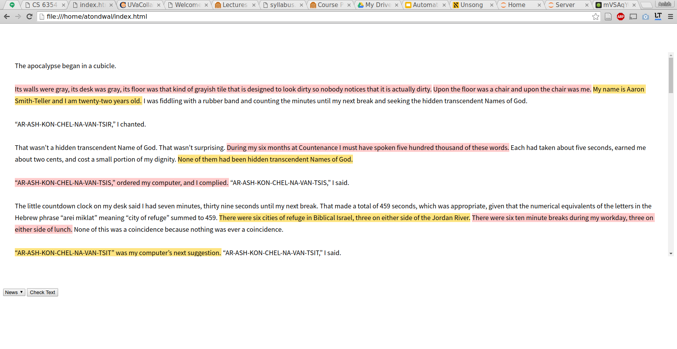
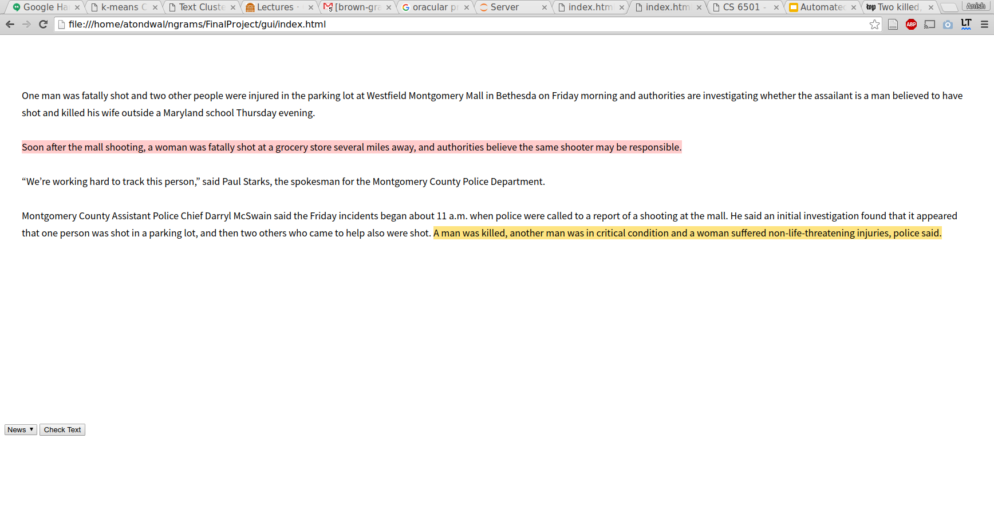
Screenshot

Slide 24
Text Suggestion
The text suggestion problem is a difficult one, but simple models can serve as a jumping-off point for the rest of our work, and to provide a standard of comparison.

Slide 25
Approach
Generate sentences using N-gram Language model(we used 5 gram language model)
Use Word2Vec Skip-Gram Model to calculate the vector representation for each newly generated sentence
Use cosine similarity between old sentence and newly generated sentences (threshold=0.8)

Slide 26
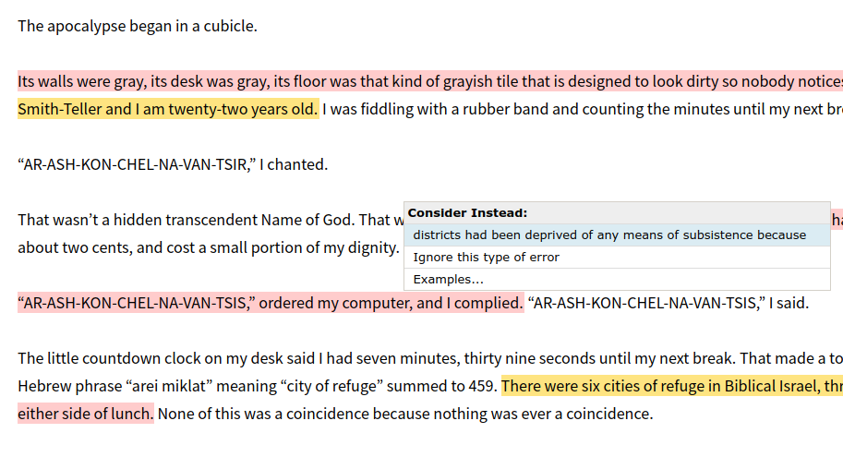
Screenshot

Slide 27
Exploring Distributed Vector Models
Word2Vec creates word embeddings.
Words that share the same contexts are semantically similar.
For sentence similarity,
We sum the vector representation of all words in a sentence
By summing them we now would not be subjected to word order
Use cosine similarity between vector to calculate their similarity(threshold = 0.8)

Slide 28
Evaluation
Cross-validation of text ratings for text highlighting with different models and different chunking lengths
Didn't find a significant difference in generalized performance.
No easy way to evaluate word2vec, as several factors like amount and quality of data used, size of vectors, training algorithm influence the quality of word vectors.

Slide 29
Future Work/Shortcomings
Text suggestions are computationally expensive, we used random search!
Try to find a more principled approach to searching for similar phrases.
Will output some irrelevant sentences which have similar word2vec vectors
Integrate suggestions with rule-based grammars
(We just suggest unpunctuated strings of words)
Finally - we need access to better “novice-English” corpora. They exist, but they are expensive. Free ones are usually very biased (only a few prompts).

Slide 30
Questions??

Slide 31
Extra Slides

Slide 32
Language Models
Generative probabilistic models of a language that gives a probability that a string is a member of a language.

Slide 33
Language Models
Uses of Language Models
Generative probabilistic models of a language that gives a probability that a string is a member of a language.
Speech Recognition
Generation
Context sensitive recognition

Slide 34
Machine Translation
IBM Models
Simple model
Mikolov et al.'s Skip-Gram and Continuous Bag of Words (CBOW) models
Learns linear mapping between vector spaces of languages.
Excellent Performance
Available as the word2vec library!

Slide 35
Evaluation
Traditionally, correction tasks are manually evaluated, which can be arduous for the researcher. Recently, crowd sourcing platforms like Amazon's Mechanical Turk have made this approach more scalable \cite{park_automated_2011}. However, several~\cite{skoufaki_exploratory_2009,lee_building_2011,wang_english_2011} methodologies for the evaluation of English writing are available in the literature. These generally focus on the evaluation of natural language produced by non-native language speakers learning the language, but several approaches seem promising for the evaluation of scientific writing. Jiang et al.~\cite{jiang_automated_2015} build a extensive corpus of novice English writing by Chinese students learning English as a second language.

Slide 36
Vector Space Representation
Represents words in a continuous vector space where semantically similar words are mapped to nearby points.
The distance between the vectors tells the relationship of words/sentence

